Slide 1


Data Science
-- Session 2--
Dimension Reduction
Phuong Do
TIC Data Science Engineer
1

Slide 2

1
2
3
4
Machine Learning Concepts
Review Machine Learning Models
Clustering &
Dimension Reduction
POC

Slide 3
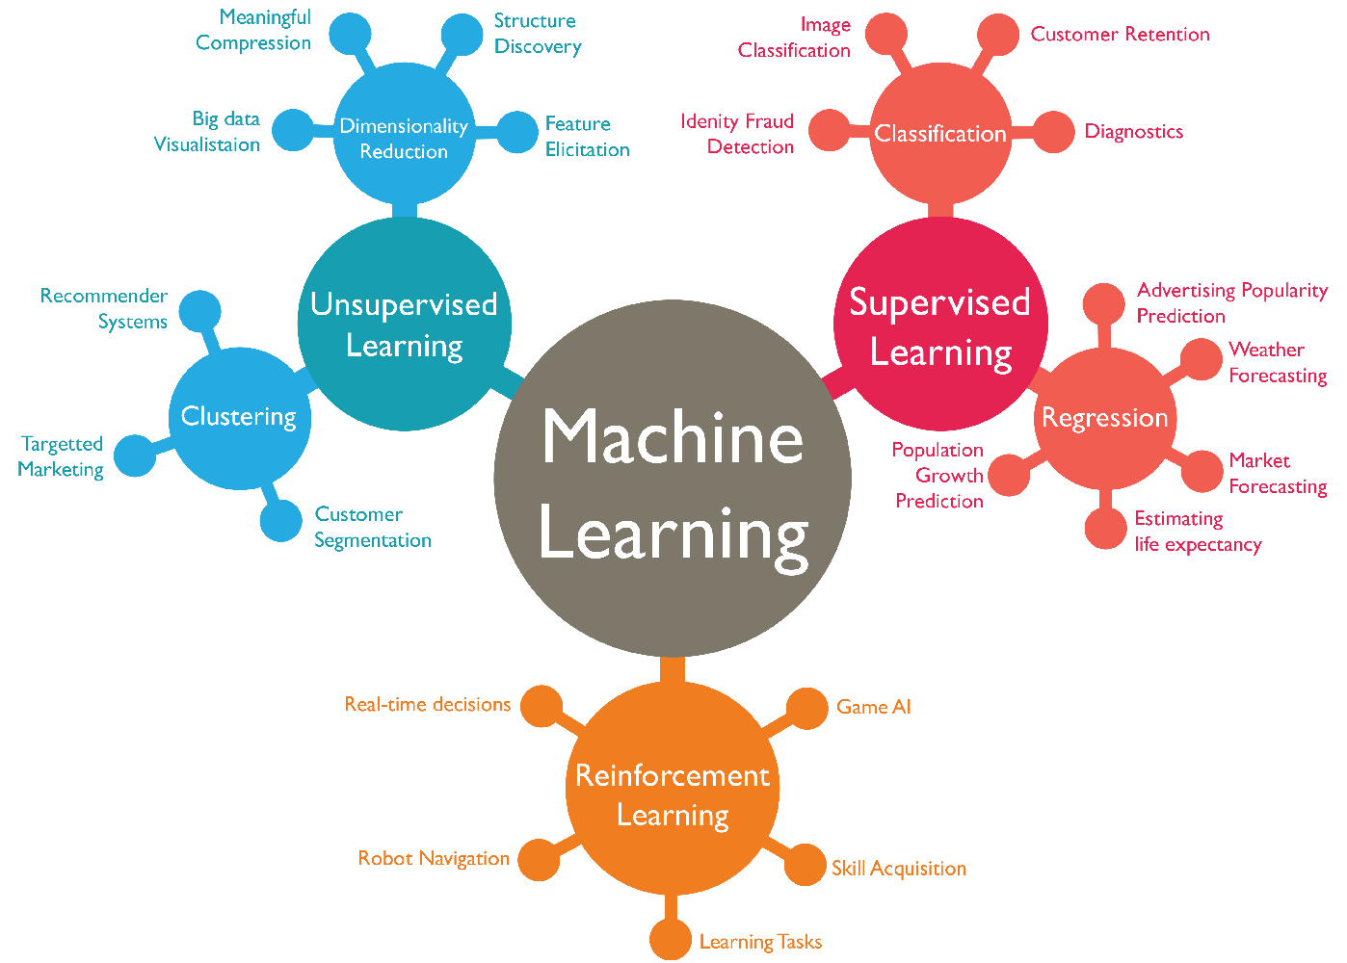
Types of learning

Slide 4
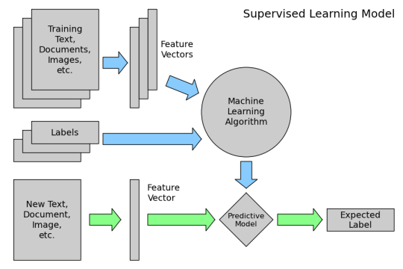
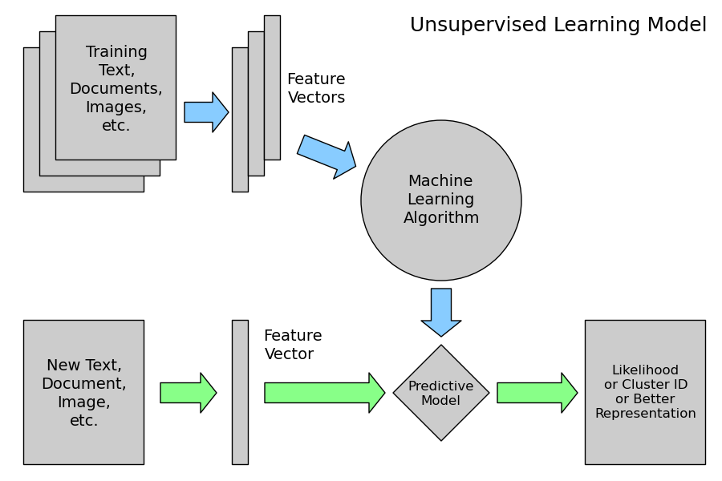
Type of learning
Supervised Learning
Unsupervised Learning

Slide 5
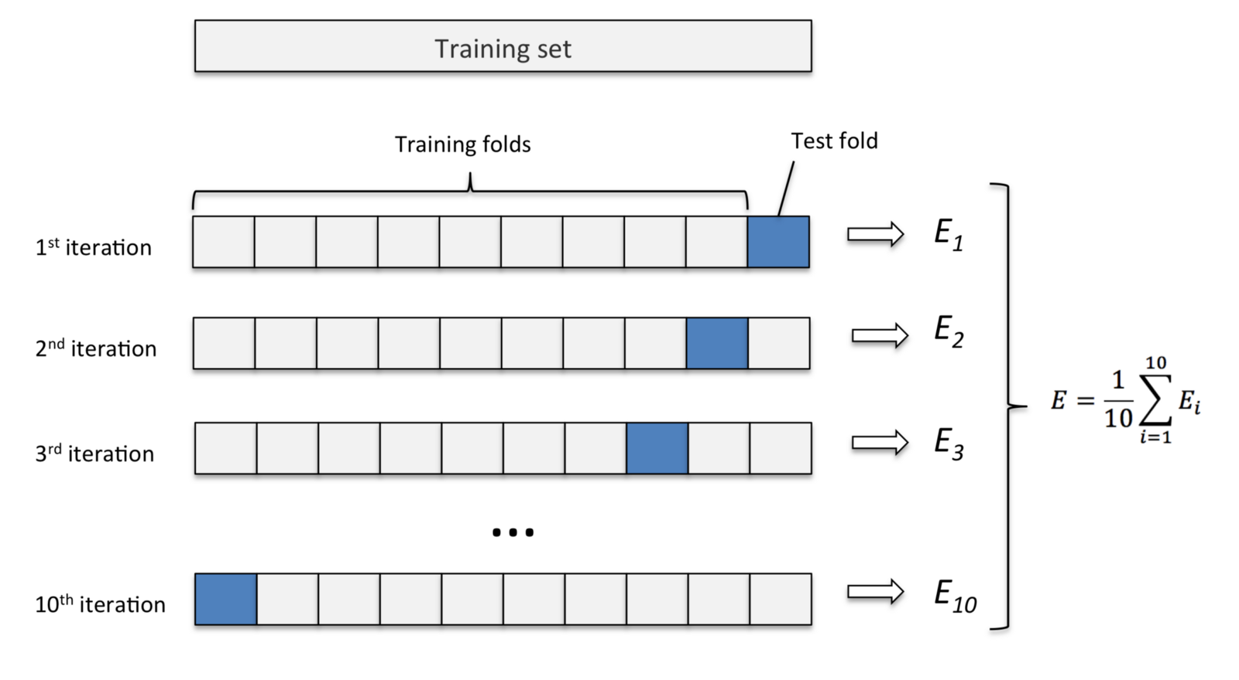
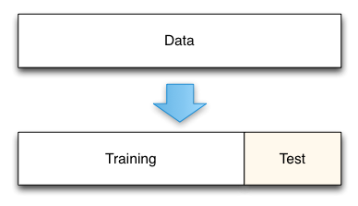
Model validation
Train-test split
Cross validation

Slide 6
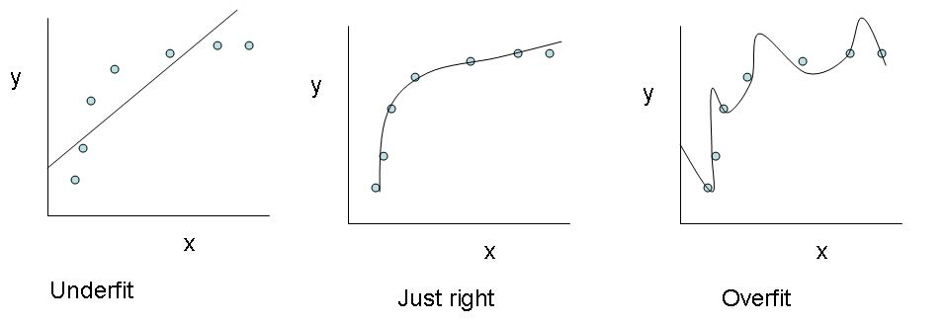
Overfit & Underfit

Slide 7
1
2
3
4
Machine Learning Concepts
Review Machine Learning Models
Clustering &
Dimension Reduction
POC

Slide 8
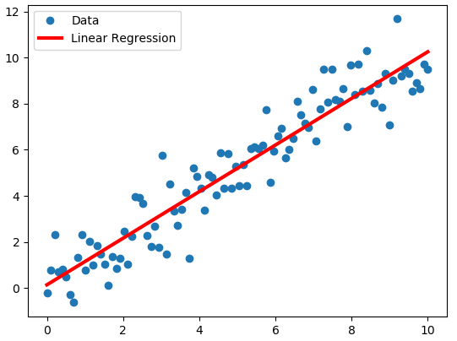
Regression Model
Linear Regression

Slide 9
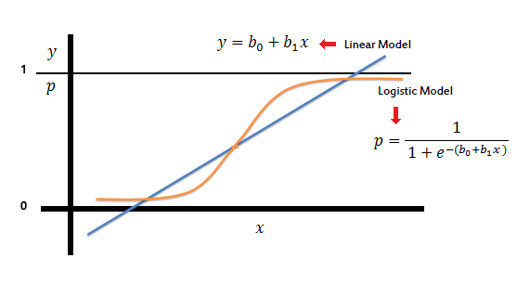
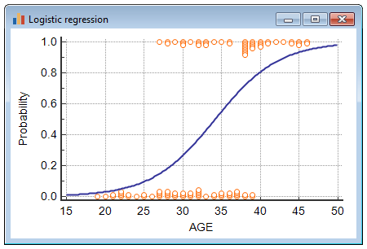
Classification Model
Linear Regression

Slide 10
Classification Model
Naïve Bayes
Cancer test:
0.1% of the population have this cancer
99% correctly identify people who have cancer
1% incorrectly identify people who are healthy

Slide 11
Classification Model
Naïve Bayes
P(C|+) = P(+,C) / P(+)
P(C|+) = P(+|C).P(C) / ( P(+|C).P(C) + P(+|not C).P(not C)
P(C|+) = 0.99 * 0.001 / ( 0.99 * 0.001 + 0.01 * 0.999 ) = 0.09

Slide 12
1
2
3
4
Machine Learning Concepts
Review Machine Learning Models
Clustering &
Dimension Reduction
POC

Slide 13
1
2
3
4
Machine Learning Concepts
Review Machine Learning Models
Clustering &
Dimension Reduction
POC

